Slide 1
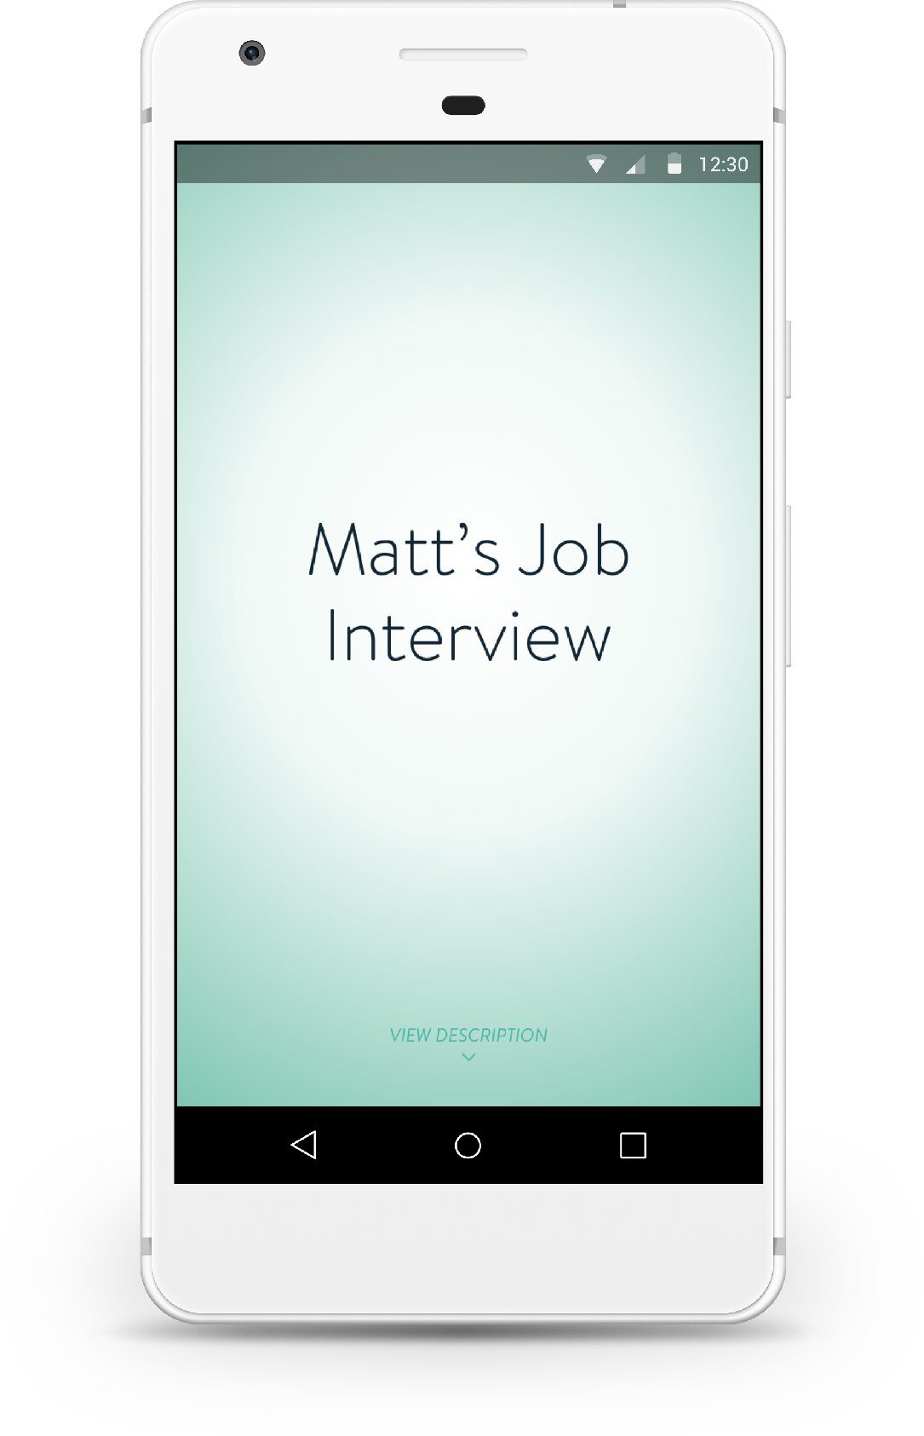
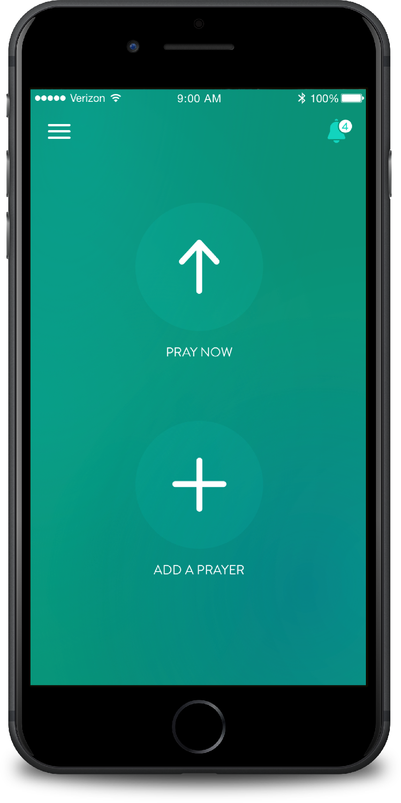
ECHO PRAYER
Use the Echo Prayer App to engage both individually and corporately with God.

Slide 2
Echo Prayer is a free app that helps you engage with God.
Download it today from the iTunes (iPhone) or Google Play (Android) Store

Slide 3
ECHO HELPS YOU:
KEEP TRACK OF YOUR PRAYERS
SHARE YOUR PRAYERS WITH OTHERS
FOLLOW CHURCHES AND MINISTRIES’ PRAYER FEEDS
BE REMINDED TO PRAY THROUGHOUT THE DAY
HAVE SPACE TO PRAY

Slide 4
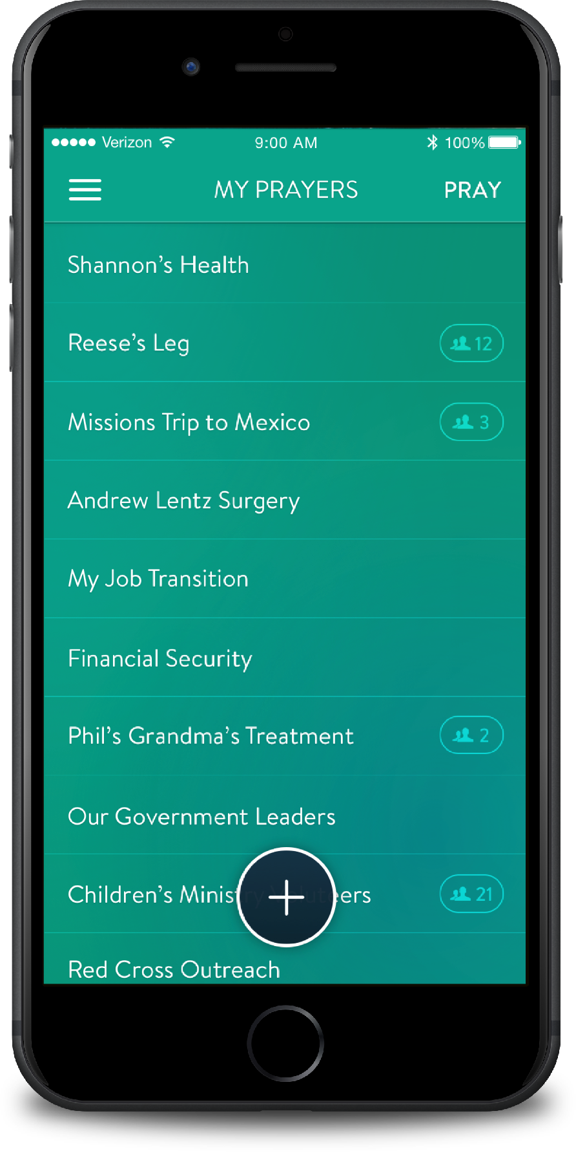
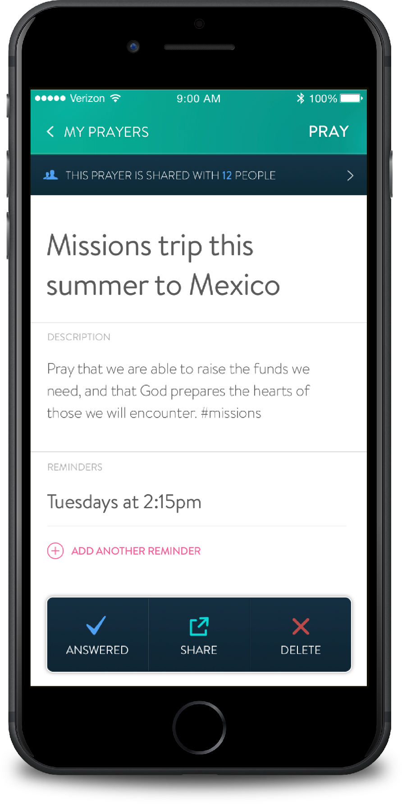
MY PRAYERS
Easily add and manage your personal prayer requests.
Keep track of answered prayers and even organize your prayers with hashtags.

Slide 5
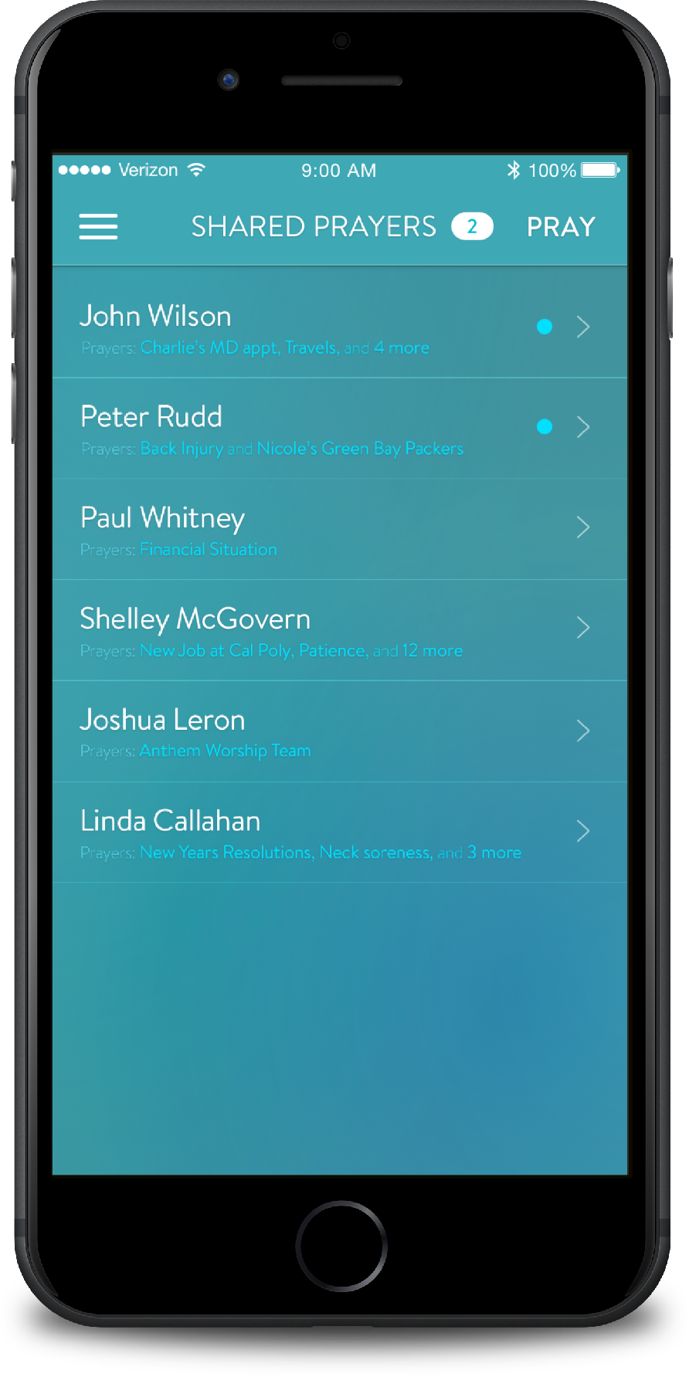
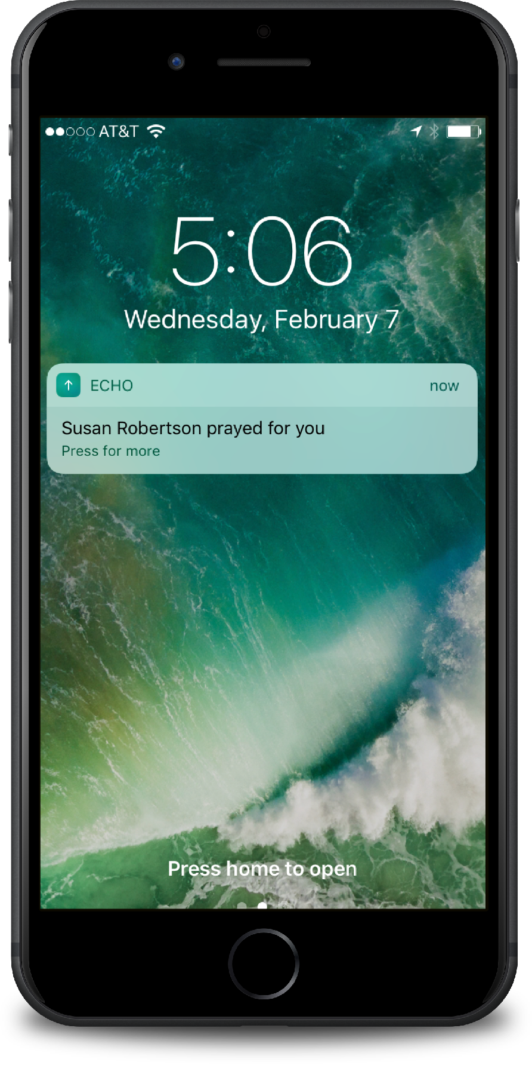
SHARING PRAYERS (with individuals)
You can share any prayer you create with other people.
Allow others to follow your prayer requests and pray for you throughout the day.

Slide 6
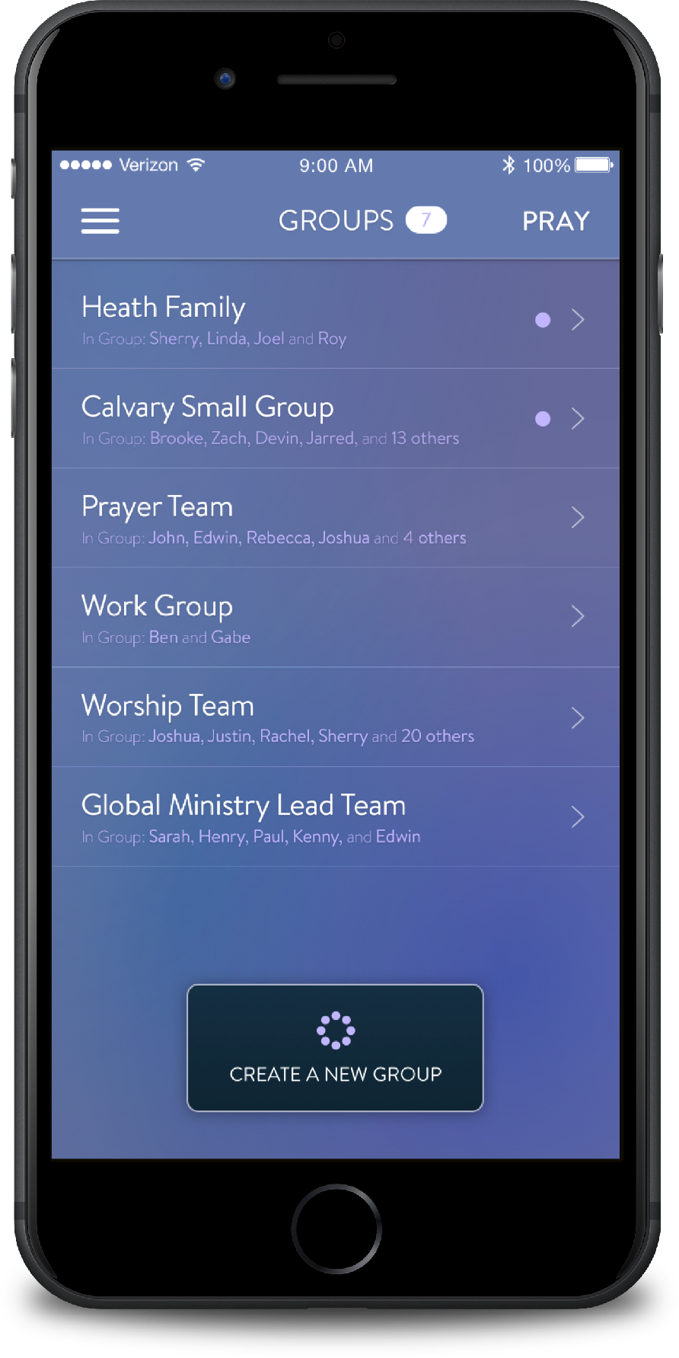
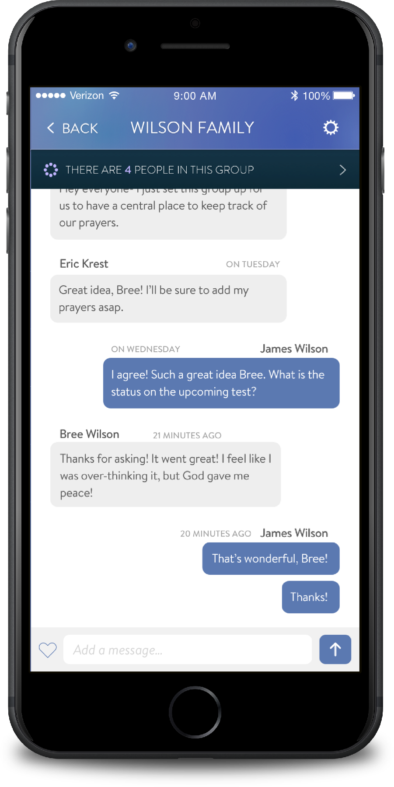
GROUPS
Create prayer groups for your small group, ministry, family, friends or co-workers.
A shared list allows everyone in the group to contribute, and provides a central place for communication.

Slide 7
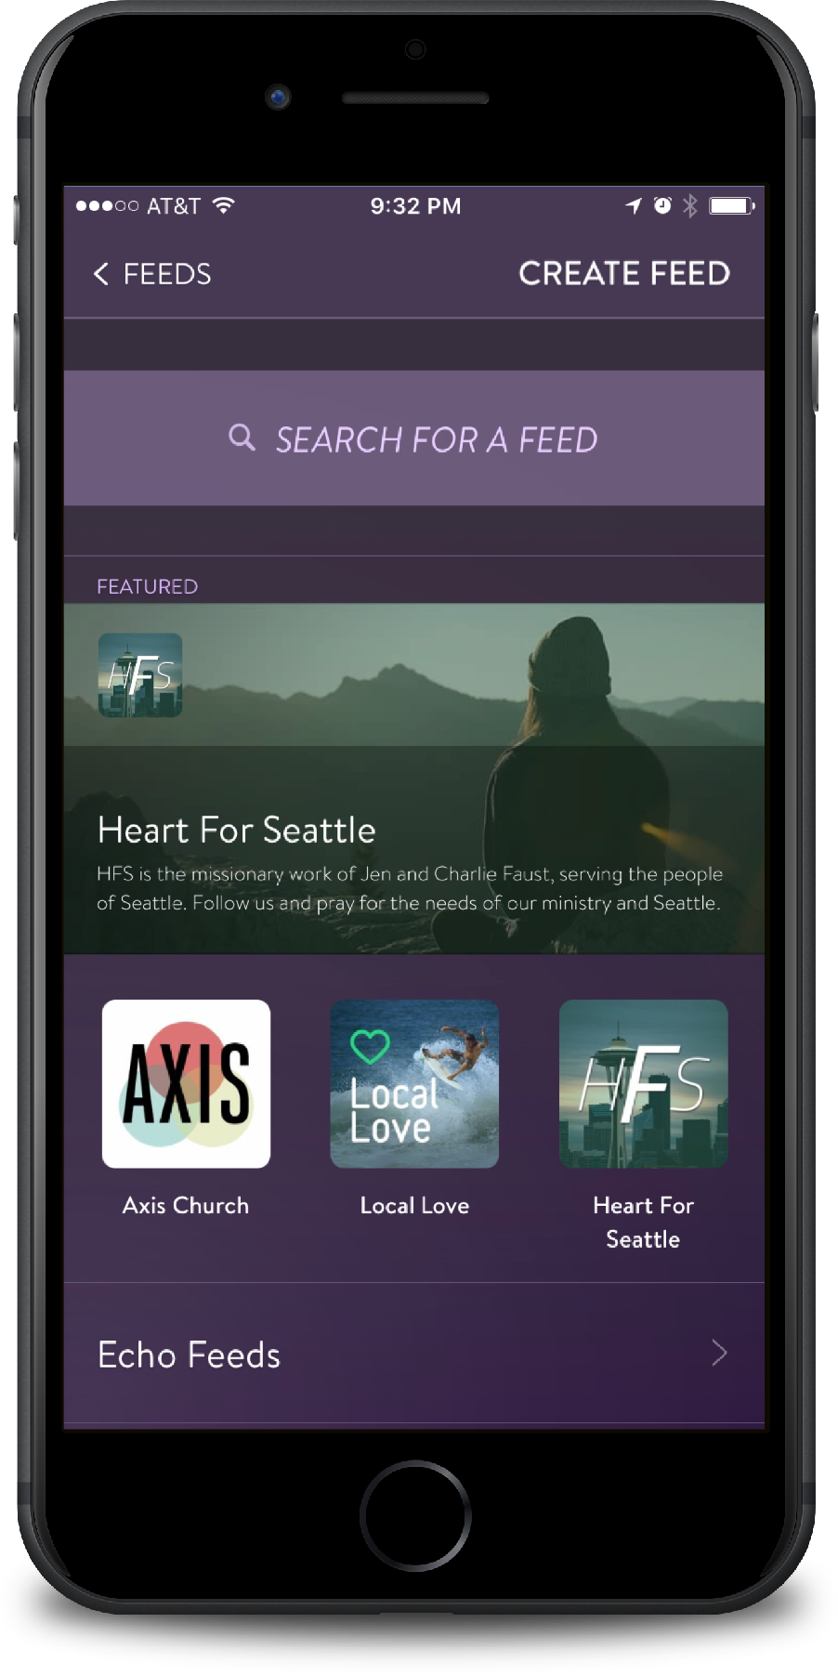
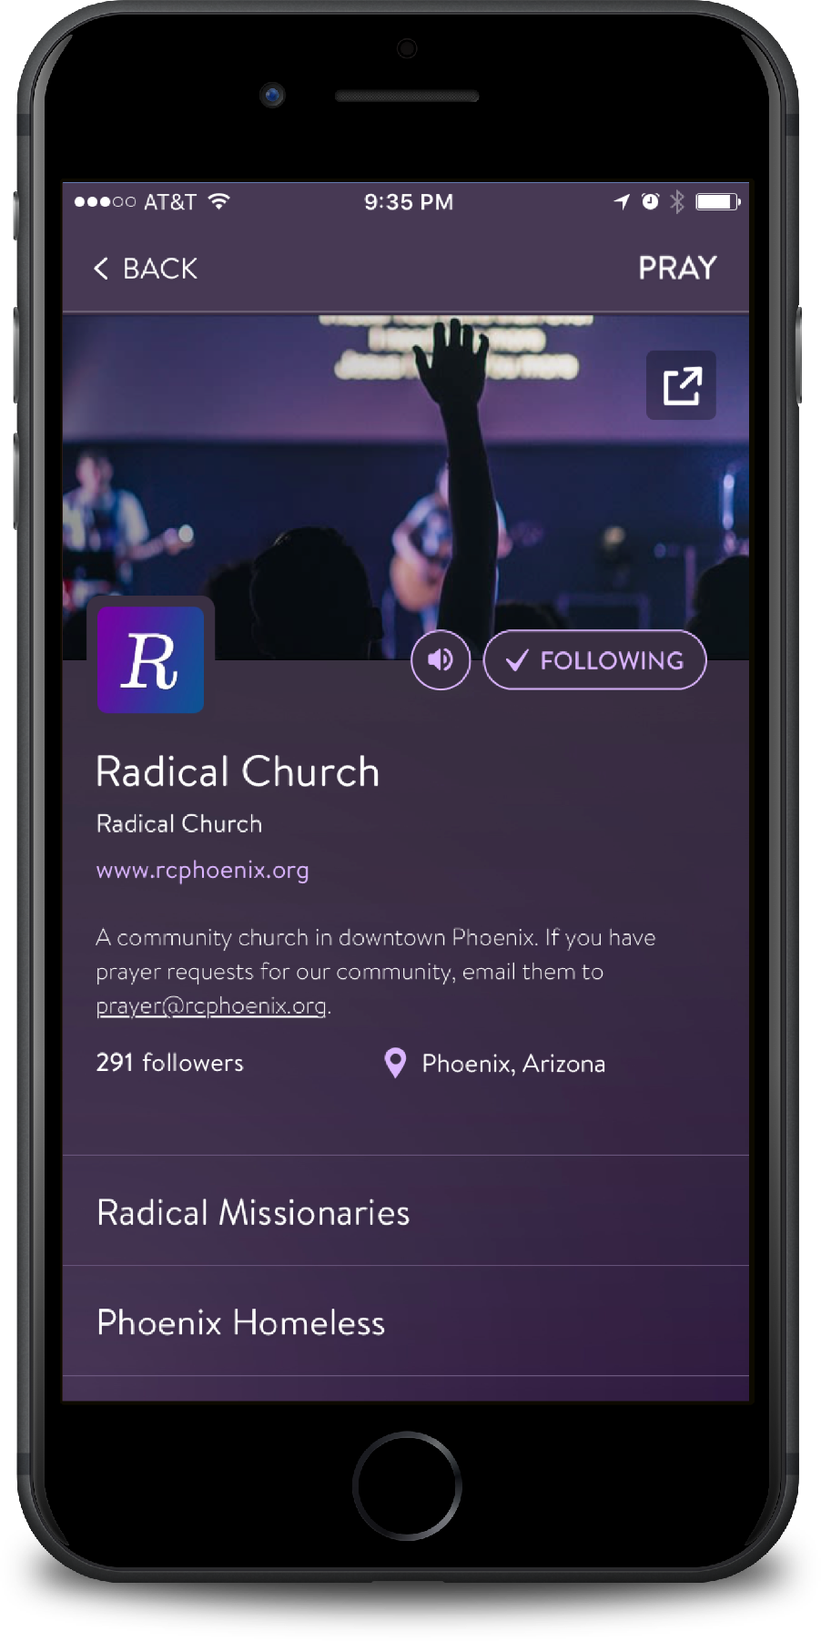
FEEDS (COMING SOON!)
Churches, missionaries, ministries, and organizations can publish prayer feeds that anyone can follow.
Engage communities to follow and pray for your ministry.

Slide 8
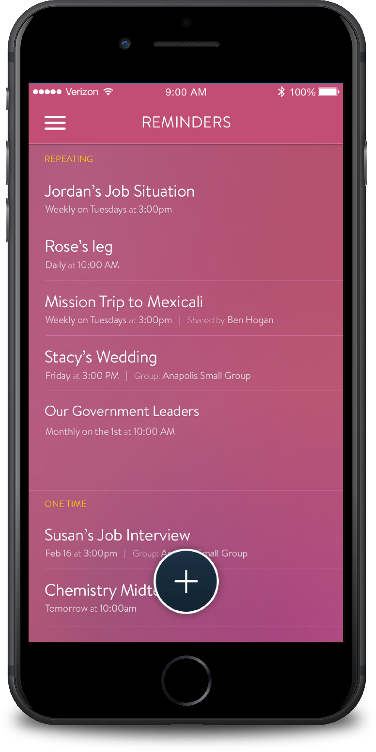
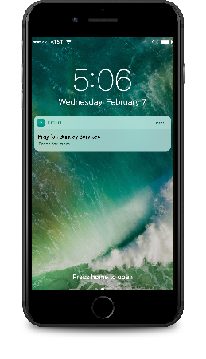
REMINDERS
Set your own customizable reminders to make sure you pray throughout the day.
Receive in-app reminders, push notifications or emails at days and times you set.

Slide 9
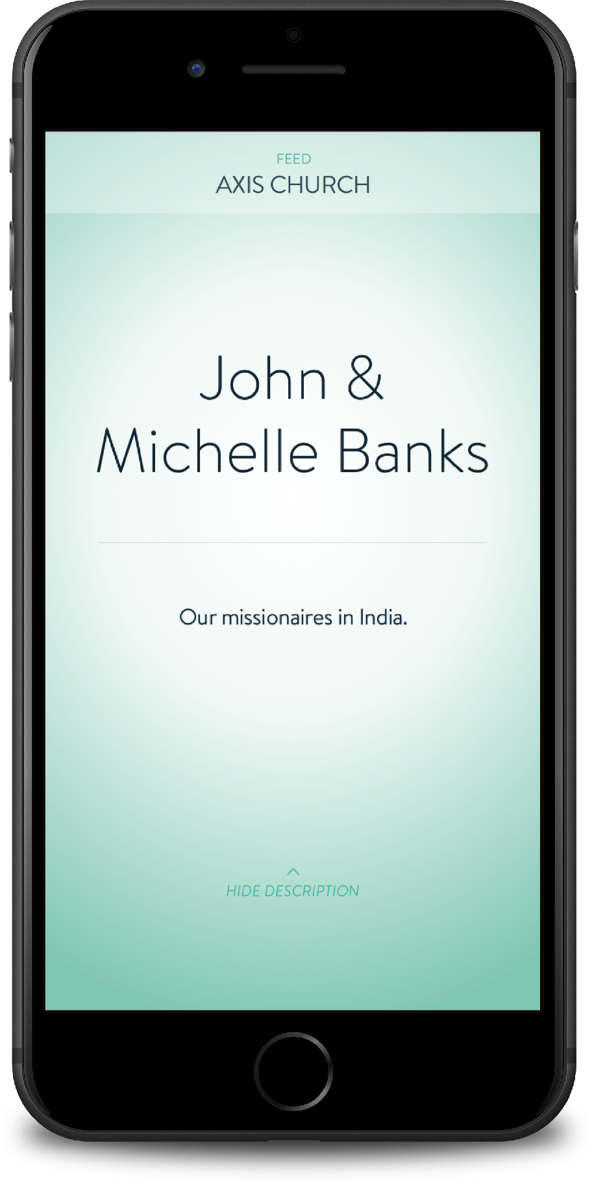
Most importantly, Echo gives you
FOCUSED SPACE TO PRAY.

Slide 10
Download the Echo Prayer App for free in iTunes and the Google Play store today!
Learn more at echoprayer.com

